Slide 1
Role Based Access Control in Azure
Notes:
Mats Warnolf
Independent Consultant
Office 365
MCT 20 years
PowerShell and Office 365

Slide 2

Access Control refers to the control over access to resources after the user have authenticated.
Notes:
When people think of Access Control they sometimes confuse it with Authentication
But it has more to do with Authorization. Controlling what the user can do once the user has authenticated properly.

Slide 3
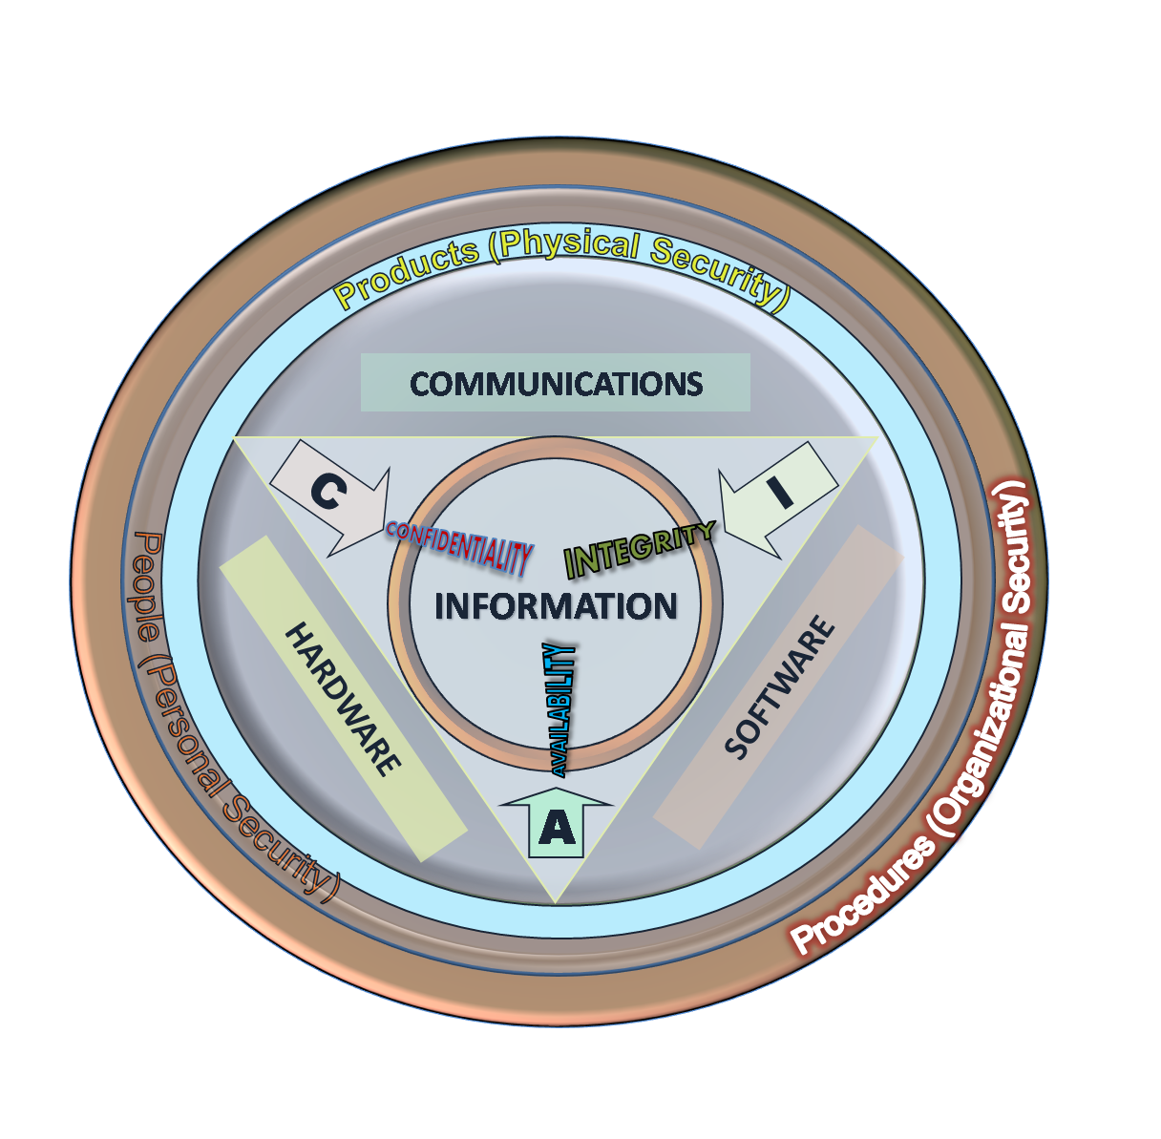
Security Triad
Confidentiality
Integrity
Availability
Notes:
The security triad is almost mandatory to bring up when we speak of security. Access Control is usually mapped to the Integrity and Confidentiality parts of the security triad.

Slide 4
Access Control in history
MAC
DAC
RBAC
Notes:
Multiple Access Control methods in history, Each one designed to solve a specific problem. As an orientation we are going to look at three access control acronyms. MAC, DAC and RBAC.

Slide 5

Models of Mandatory Access Control
Bell-LaPadula
Biba
Clark-Wilson
Brewer and Nash
Et al.
Notes:
MAC, or Mandatory access control has been around for a looooong time.
A look at wikipedia for Access Control will allow you to compare the different models
But we are going to take a quick look at two classic MAC models: Bell-LaPadula and Biba.

Slide 6
Comparison
Bell-LaPadula
Biba
Top Secret
Secret
Restricted
Unclassified
High
Equal
Low
Read up
Write down
Write Up
Read down
Confidentiality
Integrity
Notes:
Bell-LaPadula is the classic spy movie model. Everything is assigned a security label. People are assigned clearance levels.
Read down – Read my level and below. Write up – I cannot create documents with a lower Security label than my clearence level.
Biba is the opposite, but its not concerned with confidentiality, it deals with the integrity or trustworthiness of the information. A sergeant will take orders (read) from a general but not a private, and give orders (write) to a private but not a general.
Both require careful modelling of labels and levels. Very static (sometimes a benefit)

Slide 7




Discretionary Access Control
Admin
Owner
G-Controllers
User B
Finance
DL-Finance-RW
G-Finance
User A
DL-Finance-R
G-Managers
User C
A-G-DL-P
Notes:
Most common in Operating Systems.
Discretionary = Available, if you want to. Default = Everyone-Full Control
Also requires a lot of planning to be done right.
In windows classes we are taught to use the AGDLP-model

Slide 8
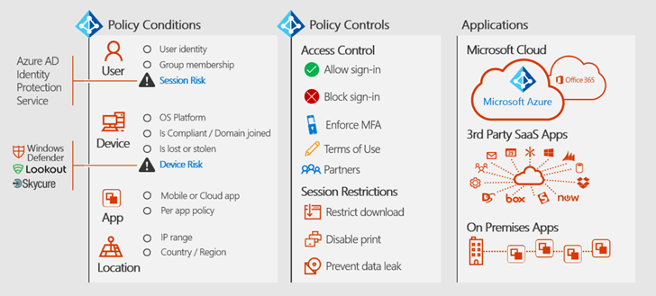
Rule Based Access Control
≈ Conditional Access
Notes:
Rule Based Access Control is about scenarios. If-Then-Else. Conditions and actions. Classic example is Conditional access or Network Access Protection/Network Policy server.

Slide 9

Role Based Access Control
Notes:
And now, we have reached the end of the orientation, and it is time to go head first into Azure Role Based Access Control.

Slide 10














Role Based Access Control
Actions
DataActions
Developer
Actions
DataActions
Operations
Actions
DataActions
DB
Actions
DataActions
Security
Notes:
The Role Based Access Control is a lot like the Discretionary Access Control. In order to provide the developers, admins, dba’s etc with the appropriate control of their respective resources, we assign Roles to them.

Slide 11
Azure RBAC roles vs Azure AD admin roles
Azure RBAC roles | Azure AD administrator roles
Manage access to Azure resources | Manage access to Azure Active Directory resources
Supports custom roles | Supports custom roles
Scope can be specified at multiple levels (management group, subscription, resource group, resource) | Scope is at the tenant level
Role information can be accessed in Azure portal, Azure CLI, Azure PowerShell, Azure Resource Manager templates, REST API | Role information can be accessed in Azure admin portal, Microsoft 365 admin center, Microsoft Graph, AzureAD PowerShell
Notes:
There is Role Based administration in Azure AD as well, it is similar in some cases and different in others.
The most important difference is the Scope of the roles. In Azure AD we are not yet able to scope all of the roles to different administrative units.

Slide 12
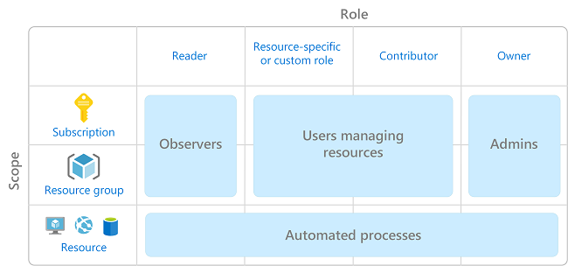
Role Based Access Control
in Azure
Notes:
In Azure Role Based Access Control we have four global roles: Reader, Contributor, Owner and User Access Administrator. But there are many more Resource Specific roles.
We typically assign the roles to Subsription or Resource group scope.
But we can assign the role for specific resources but this is generally only used for automation.

Slide 13
Built in Azure RBAC Roles
Contributor
Owner
Reader
User Access Administrator
AcrPush
API Management Service Contributor
AcrPull
AcrImageSigner
AcrDelete
AcrQuarantineReader
AcrQuarantineWriter
API Management Service Operator Role
API Management Service Reader Role
Application Insights Component Contributor
Application Insights Snapshot Debugger
Attestation Reader
Automation Job Operator
Automation Runbook Operator
Automation Operator
Avere Contributor
Avere Operator
Azure Kubernetes Service Cluster Admin Role
Azure Kubernetes Service Cluster User Role
Azure Maps Data Reader (Preview)
Azure Stack Registration Owner
Backup Contributor
Billing Reader
Backup Operator
Backup Reader
Blockchain Member Node Access (Preview)
BizTalk Contributor
CDN Endpoint Contributor
CDN Endpoint Reader
CDN Profile Contributor
CDN Profile Reader
Classic Network Contributor
Classic Storage Account Contributor
Classic Storage Account Key Operator Service Role
ClearDB MySQL DB Contributor
Classic Virtual Machine Contributor
Cognitive Services User
Cognitive Services Data Reader (Preview)
Cognitive Services Contributor
CosmosBackupOperator
Cosmos DB Account Reader Role
Cost Management Contributor
Cost Management Reader
Data Box Contributor
Data Box Reader
Data Factory Contributor
Data Purger
Data Lake Analytics Developer
DevTest Labs User
DocumentDB Account Contributor
DNS Zone Contributor
EventGrid EventSubscription Contributor
EventGrid EventSubscription Reader
Graph Owner
HDInsight Domain Services Contributor
Intelligent Systems Account Contributor
Key Vault Contributor
Knowledge Consumer
Lab Creator
Log Analytics Reader
Log Analytics Contributor
Logic App Operator
Logic App Contributor
Managed Application Operator Role
Managed Applications Reader
Managed Identity Operator
Managed Identity Contributor
Management Group Contributor
Management Group Reader
Monitoring Metrics Publisher
Monitoring Reader
Network Contributor
Monitoring Contributor
New Relic APM Account Contributor
Redis Cache Contributor
Reader and Data Access
Resource Policy Contributor (Preview)
Scheduler Job Collections Contributor
Search Service Contributor
Security Admin
Security Manager (Legacy)
Security Reader
Spatial Anchors Account Contributor
Site Recovery Contributor
Site Recovery Operator
Spatial Anchors Account Reader
Site Recovery Reader
Spatial Anchors Account Owner
SQL Managed Instance Contributor
SQL DB Contributor
SQL Security Manager
Storage Account Contributor
SQL Server Contributor
Storage Account Key Operator Service Role
Storage Blob Data Contributor
Storage Blob Data Owner
Storage Blob Data Reader
Storage Queue Data Contributor
Storage Queue Data Message Processor
Storage Queue Data Message Sender
Storage Queue Data Reader
Support Request Contributor
Traffic Manager Contributor
Virtual Machine Administrator Login
Virtual Machine User Login
Virtual Machine Contributor
Web Plan Contributor
Website Contributor
Azure Service Bus Data Owner
Azure Event Hubs Data Owner
Attestation Contributor
HDInsight Cluster Operator
Cosmos DB Operator
Hybrid Server Resource Administrator
Hybrid Server Onboarding
Azure Event Hubs Data Receiver
Azure Event Hubs Data Sender
Azure Service Bus Data Receiver
Azure Service Bus Data Sender
Storage File Data SMB Share Reader
Storage File Data SMB Share Contributor
Private DNS Zone Contributor
Storage Blob Delegator
Desktop Virtualization User
Storage File Data SMB Share Elevated Contributor
Blueprint Contributor
Blueprint Operator
Azure Sentinel Contributor
Azure Sentinel Responder
Azure Sentinel Reader
Workbook Reader
Workbook Contributor
Policy Insights Data Writer (Preview)
SignalR AccessKey Reader
SignalR Contributor
Altretya test Service Role
https://docs.microsoft.com/en-us/azure/role-based-access-control/built-in-roles#built-in-role-descriptions
Notes:
There are quite a few available built in roles, at least one per resource type, and the list of resource types do not appear to be shrinking. This list was created about a month ago when there was 137 resource specific roles in Azure.

Slide 14
Creating Custom Roles
Pure Powershell
JSON file
$role = Get-AzRoleDefinition "Virtual Machine Contributor"
$role.Id = $null
$role.Name = "Virtual Machine Operator"
$role.Description = "Can monitor and restart virtual machines."
$role.Actions.Clear()
$role.Actions.Add("Microsoft.Storage/*/read")
$role.Actions.Add("Microsoft.Network/*/read")
$role.Actions.Add("Microsoft.Compute/*/read")
$role.Actions.Add("Microsoft.Compute/virtualMachines/start/action")
$role.Actions.Add("Microsoft.Compute/virtualMachines/restart/action")
$role.Actions.Add("Microsoft.Authorization/*/read")
$role.Actions.Add("Microsoft.ResourceHealth/availabilityStatuses/read")
$role.Actions.Add("Microsoft.Resources/subscriptions/resourceGroups/read")
$role.Actions.Add("Microsoft.Insights/alertRules/*")
$role.Actions.Add("Microsoft.Support/*")
$role.AssignableScopes.Clear()
$role.AssignableScopes.Add("/subscriptions/00000000-0000-0000-0000-000000000000")
$role.AssignableScopes.Add("/subscriptions/11111111-1111-1111-1111-111111111111")
New-AzRoleDefinition -Role $role
{
"Name": "Virtual Machine Operator",
"Id": "88888888-8888-8888-8888-888888888888",
"IsCustom": true,
"Description": "Can monitor and restart virtual machines.",
"Actions": [
"Microsoft.Storage/*/read",
"Microsoft.Network/*/read",
"Microsoft.Compute/*/read",
"Microsoft.Compute/virtualMachines/start/action",
"Microsoft.Compute/virtualMachines/restart/action",
"Microsoft.Authorization/*/read",
"Microsoft.ResourceHealth/availabilityStatuses/read",
"Microsoft.Resources/subscriptions/resourceGroups/read",
"Microsoft.Insights/alertRules/*",
"Microsoft.Insights/diagnosticSettings/*",
"Microsoft.Support/*"
],
"NotActions": [],
"DataActions": [],
"NotDataActions": [],
"AssignableScopes": [
"/subscriptions/{subscriptionId1}",
"/subscriptions/{subscriptionId2}",
"/subscriptions/{subscriptionId3}"
]
}
Notes:
When we create custom roles we can use PowerShell or CLI. We can use pure powershell but I typically use a JSON file to do it. One of the reasons is that... (click)

Slide 15
Role definitions
Format
{Company}.{ProviderName}/{resourceType}/{action}
Name
Id
IsCustom
Description
Actions []
NotActions []
DataActions []
NotDataActions []
AssignableScopes []
{
"Name": "Contributor",
"Id": "b24988ac-6180-42a0-ab88-20f7382dd24c",
"IsCustom": false,
"Description": "Lets you manage everything except access to resources.",
"Actions": [
"*"
],
"NotActions": [
"Microsoft.Authorization/*/Delete",
"Microsoft.Authorization/*/Write",
"Microsoft.Authorization/elevateAccess/Action"
],
"DataActions": [],
"NotDataActions": [],
"AssignableScopes": [
"/"
]
}
* / Read / Write / Action / Delete
Notes:
The role definitions are typically retreived in json format.
This is the retrieved definition of the Contributor role. We see the name, the ID, the description and the actions.

Slide 16
Format
{Company}.{ProviderName}/{resourceType}/{action}
Name
Id
IsCustom
Description
Actions []
NotActions []
DataActions []
NotDataActions []
AssignableScopes []
{
"Name": "Contributor",
"Id": "b24988ac-6180-42a0-ab88-20f7382dd24c",
"IsCustom": false,
"Description": "Lets you manage everything except access to resources.",
"Actions": [
"*"
],
"NotActions": [
"Microsoft.Authorization/*/Delete",
"Microsoft.Authorization/*/Write",
"Microsoft.Authorization/elevateAccess/Action"
],
"DataActions": [],
"NotDataActions": [],
"AssignableScopes": [
"/"
]
}
Actions
Operations the role is allowed to perform.
NotActions
Specific exceptions from the allowed actions
* / Read / Write / Action / Delete
Notes:
The actions in this case is an asterisk, meaning that we are allowed to do ANYTHING WE WANT.
But then of course there is a node called NotActions that is specific exceptions to the Actions node.

Slide 17
Format
{Company}.{ProviderName}/{resourceType}/{action}
Name
Id
IsCustom
Description
Actions []
NotActions []
DataActions []
NotDataActions []
AssignableScopes []
{
"Name": "Contributor",
"Id": "b24988ac-6180-42a0-ab88-20f7382dd24c",
"IsCustom": false,
"Description": "Lets you manage everything except access to resources.",
"Actions": [
"*"
],
"NotActions": [
"Microsoft.Authorization/*/Delete",
"Microsoft.Authorization/*/Write",
"Microsoft.Authorization/elevateAccess/Action"
],
"DataActions": [],
"NotDataActions": [],
"AssignableScopes": [
"/"
]
}
DataActions
Data operations the role is allowed to perform.
NotDataActions
Specific exceptions from the allowed actions
Microsoft.Storage/storageAccounts/ blobServices/containers/blobs/read
(read blobs within the specific storage account
* / Read / Write
Notes:
The DataActions and NotDataActions are similar. (we see them used in things like storage, databases etc)

Slide 18
Format
{Company}.{ProviderName}/{resourceType}/{action}
Name
Id
IsCustom
Description
Actions []
NotActions []
DataActions []
NotDataActions []
AssignableScopes []
{
"Name": "Contributor",
"Id": "b24988ac-6180-42a0-ab88-20f7382dd24c",
"IsCustom": false,
"Description": "Lets you manage everything except access to resources.",
"Actions": [
"*"
],
"NotActions": [
"Microsoft.Authorization/*/Delete",
"Microsoft.Authorization/*/Write",
"Microsoft.Authorization/elevateAccess/Action"
],
"DataActions": [],
"NotDataActions": [],
"AssignableScopes": [
"/"
]
}
Assignable Scopes
Specifies which scope(s) where this role definition should be available
"/subscriptions/{subscriptionId1}” (everything in a specific subscription)
"/subscriptions/{subscriptionId1}/resourceGroups/Network" (Everything in a specific resource group)
"/” (Only built in roles)
Notes:
At the end of the definition we say in what scope this role should be available.

Slide 19
Multiple Roles
{
"Name": ”A Role",
"Id": "b24988ac-6180-42a0-ab88-20f7382dd24c",
"IsCustom": true,
"Description": ”A description of the role",
"Actions": [
"*"
],
"NotActions": [
"Microsoft.Authorization/*/Delete",
"Microsoft.Authorization/*/Write",
"Microsoft.Authorization/elevateAccess/Action"
],
"DataActions": [],
"NotDataActions": [],
"AssignableScopes": [
"/"
]
}
If a user is assigned a role that excludes an operation in NotActions, and is assigned a second role that grants access to the same operation, the user is allowed to perform that operation. NotActions is not a deny rule – it is simply a convenient way to create a set of allowed operations when specific operations need to be excluded.
There is another way: Deny Assignments
{
"Name": ”AnotherRole",
"Id": "b24988ac-6180-42a0-ab88-20f7382dd24d",
"IsCustom": true,
"Description": ”Another description",
"Actions": [
"*"
],
"NotActions": [
"Microsoft.Authorization/*/Write",
"Microsoft.Authorization/elevateAccess/Action"
],
"DataActions": [],
"NotDataActions": [],
"AssignableScopes": [
"/"
]
}
Notes:
Now, we should note that a user can be assigned multiple roles, even conflicting roles where one role clearly states in a ”NotAction” something that the role holder should not be able to do, and the other role clearly states the the role holder should be able to perform. Let’s examine this. What will the result be?
The user will be able to perform the action.
This doesn’t behave like a deny-rule.
By the way there is something called Deny Assignments, but that is outside the scope of this presentation because I have never gotten to play with it.

Slide 20
Custom Roles
{
"Name": "Virtual Machine Operator",
"Id": "88888888-8888-8888-8888-888888888888",
"IsCustom": true,
"Description": "Can monitor and restart virtual machines.",
"Actions": [
"Microsoft.Storage/*/read",
"Microsoft.Network/*/read",
"Microsoft.Compute/*/read",
"Microsoft.Compute/virtualMachines/start/action",
"Microsoft.Compute/virtualMachines/restart/action",
"Microsoft.Authorization/*/read",
"Microsoft.ResourceHealth/availabilityStatuses/read",
"Microsoft.Resources/subscriptions/resourceGroups/read",
"Microsoft.Insights/alertRules/*",
"Microsoft.Insights/diagnosticSettings/*",
"Microsoft.Support/*"
],
"NotActions": [],
"DataActions": [],
"NotDataActions": [],
"AssignableScopes": [
"/subscriptions/{subscriptionId1}",
"/subscriptions/{subscriptionId2}",
"/subscriptions/{subscriptionId3}"
]
}
You are going to have to spend some time figuring out what the role should be allowed and disallowed.
Please look at the role definitions for the built-in roles to figure out what your roles need.
Notes:
When creating a custom role we often have at least a vague idea of what the role holder should be able to do. But we are going to have to figure it out. One way is to look at the avaliable built in roles and try to find appropriate examples. We are also going to have to test our roles...

Slide 21
Custom Roles – PowerShell is your friend
Owners or User Access Administrators
New-AzRoleDefinition -InputFile [JSON file]
Get-AzRoleDefinition
Get-AzRoleDefinition -Custom
$ReaderRoleParameters = @{
SignInName = $UserPrincipalName;
RoleDefinitionName = "Reader";
Scope = $SubscriptionScope
}
New-AzRoleAssignment @ReaderRoleParameters
Get-AzRoleAssignment -RoleDefinitionName "Reader"
https://github.com/matswarnolf/AzureAD_RBAC
Notes:
PowerShell is a good friend. You can find all the code in my demo on github.
(Gå igenom raderna snabbt)
Wanna see it in action?
Demo-time

Slide 22

Demos…

Slide 23
Limits in Azure RBAC
Resource | Limit**
Role assignments for Azure resources per Azure subscription | 2,000
Role assignments for Azure resources per management group* | 500
Custom roles for Azure resources per tenant | 5,000
Custom roles for Azure resources per tenant (specialized clouds, such as Azure Government, Azure Germany, and Azure China 21Vianet) | 2,000
* This became available in May 2019
** Reduce the number of role assignments by assigning roles to groups instead
Notes:
There ARE some limits on role holder assignments and on the number of custom roles you can create.

Slide 24
What about Azure AD?
16 new admin roles recently shipped, more on the way. A total of 63 available
Still some places that require Global Admin. Azure AD top priority is addressing this
In the pipeline is support for
Custom roles
Departmental scoping
Groups as members of roles
Notes:
The recommendation around Global Admins in Azure AD is to stay below five, the fewer the better. But no less than two in my humble opinion. The development in Azure AD have been focused around other problems than roles. Some things still require Global Admin role to perform. But the new Global Reader role removed a lot of reasons to assign the Global admin role

Slide 25
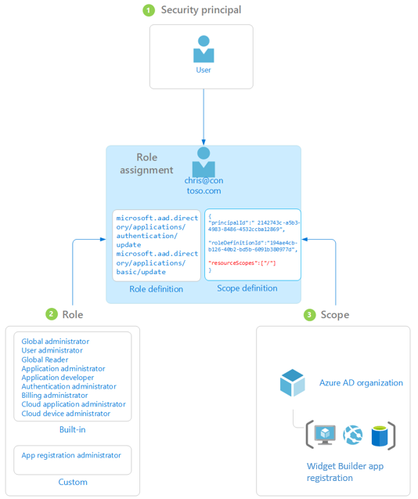
Custom roles in Azure AD (preview)
Requires Azure AD P1 or better
Scope is Directory or Resource
Notes:
To create a custm role in Azure AD we must have the right license.
The scope of custom roles is different between Built-in roles and custom roles right now:
Custom roles are scoped at Directory or Azure AD resource, but not yet a Administrative Unit
Built-in roles are scoped at directory and in some cases Administrative Unit (but cannot be scoped to an Azure AD resource.

Slide 26

Current Built in Azure AD Roles (63)
Company Administrator
Guest User
Guest Inviter
User Account Administrator
Helpdesk Administrator
Service Support Administrator
Billing Administrator
User
Partner Tier1 Support
Partner Tier2 Support
Directory Readers
Directory Writers
Exchange Service Administrator
SharePoint Service Administrator
Lync Service Administrator
Device Users
Device Administrators
Device Join
Workplace Device Join
Compliance Administrator
Directory Synchronization Accounts
Device Managers
Application Administrator
Application Developer
Security Reader
Security Administrator
Privileged Role Administrator
Intune Service Administrator
Cloud Application Administrator
Customer LockBox Access Approver
CRM Service Administrator
Power BI Service Administrator
Conditional Access Administrator
Reports Reader
Message Center Reader
Azure Information Protection Administrator
Desktop Analytics Administrator
License Administrator
Cloud Device Administrator
Authentication Administrator
Privileged Authentication Administrator
Teams Communications Administrator
Teams Communications Support Engineer
Teams Communications Support Specialist
Teams Service Administrator
Message Center Privacy Reader
B2C User Flow Administrator
B2C User Flow Attribute Administrator
B2C IEF Keyset Administrator
B2C IEF Policy Administrator
External Identity Provider Administrator
Compliance Data Administrator
Security Operator
Kaizala Administrator
Global Reader
Search Administrator
Search Editor
Password Administrator
Printer Administrator
Printer Technician
Groups Administrator
Azure DevOps Administrator
Office Apps Administrator
Notes:
There are 63 role templates with the newly added 16, and there are more to come. But like in Azure RBAC, custom roles will be a huge thing when its ready.

Slide 27
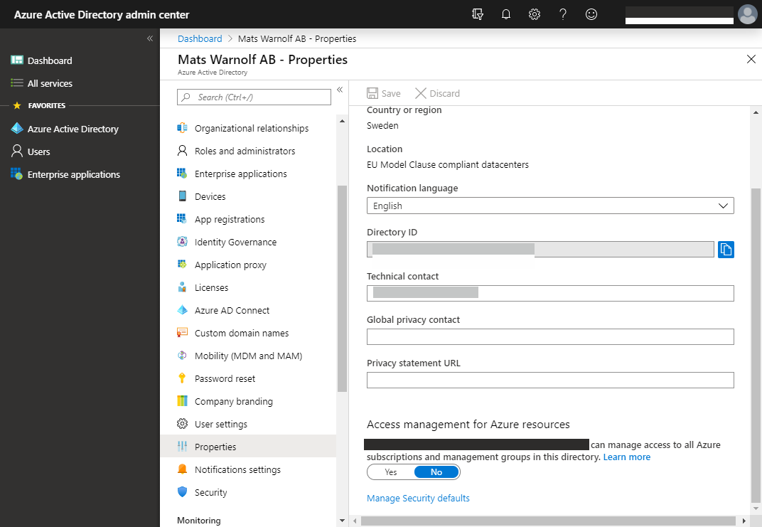
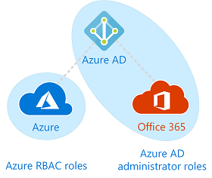
Roles do not span services default
Notes:
Roles do not cross the services boundry, meaning that the a role in Azure AD typically cannot access resources in Azure. There is one notable exception and that is that a global admin can be given access to manage subscription and Management Groups in Azure.

Slide 28
Links
https://docs.microsoft.com/en-us/azure/role-based-access-control/troubleshooting
https://docs.microsoft.com/en-us/azure/role-based-access-control/deny-assignments

Slide 29



Sorry for the shameless plug, Thanks for Listening
mats@warnolf.net
Notes:
My bi-weekly podcast in swedish about Office 365 is available on iTunes, Spotify, TuneIn Radio etc..
Thanks for listening!

